Slide 1
Manufacturing Technology
30/01/2018 (ME461)
Instructor: Shantanu Bhattacharya

Slide 2
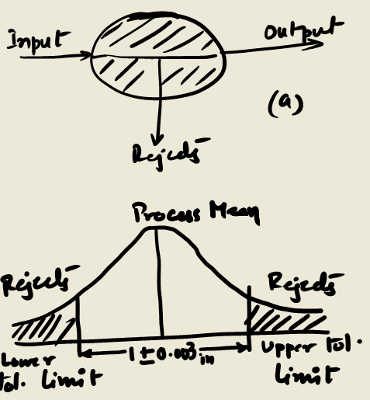
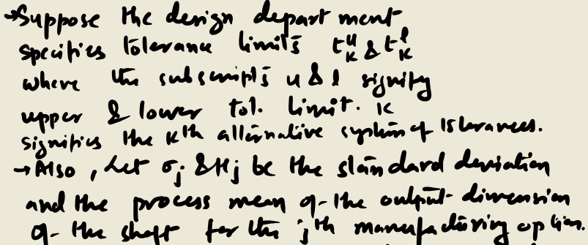
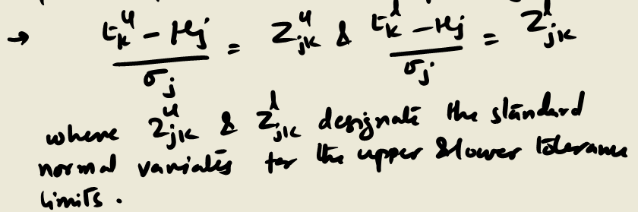
Mathematical Model for understanding interactions between design and manufacturing in a turning process of a cylindrical shaft
We consider a simple product, a cylindrical shaft.
The design stage is concerned with specifying tolerances on the shaft.
The manufacturing stage is essentially a transformation process, changing a bar stock into a finished shaft meeting tolerance specification.
The transformation process indicating inputs and outputs is shown in (a) and the unit normal curve indicating tolerances and the fraction rejects in (b)

Slide 3

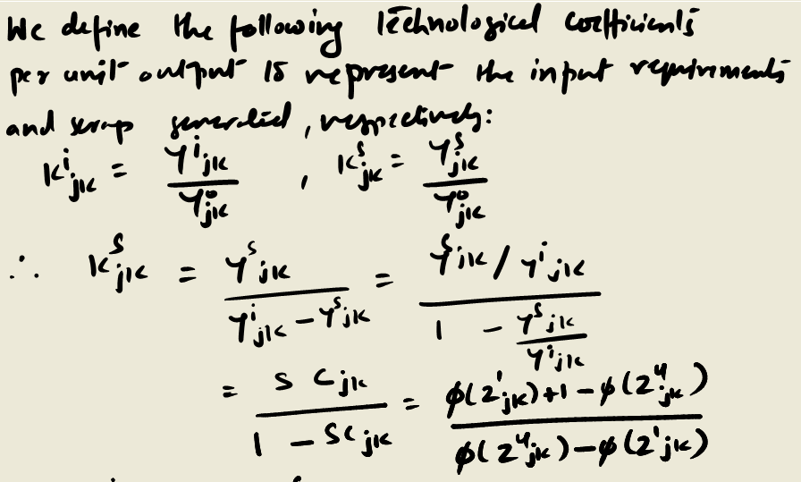
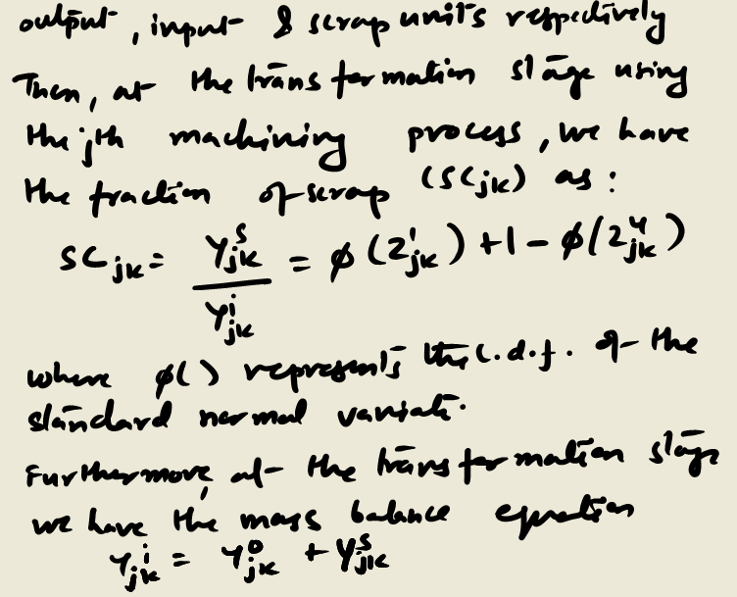
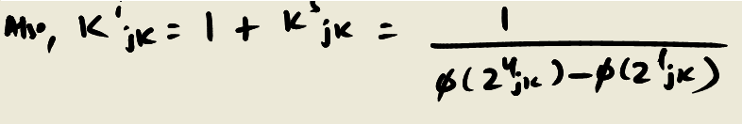
Mathematical Model for understanding interactions between design and manufacturing in a turning process of a cylindrical shaft
We present a simple analysis without rework. This means that the shafts below the lower tolerance limits and above the upper tolerance limits are scrapped.

Slide 4
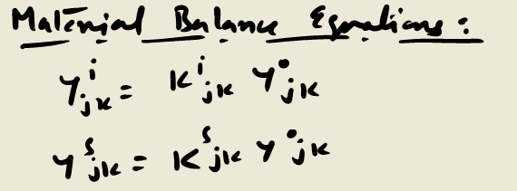
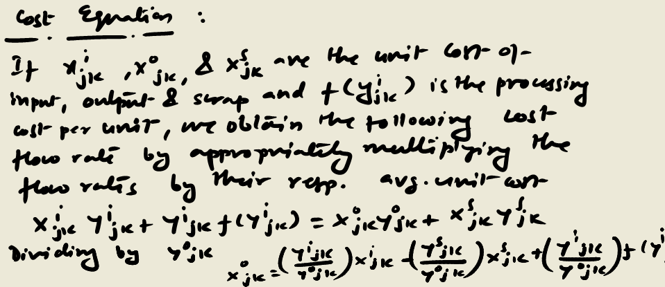


Mathematical Model for understanding interactions between design and manufacturing in a turning process of a cylindrical shaft

Slide 5
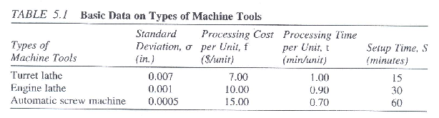
Numerical Problem
Suppose 500 units of a shaft are to be manufactured within 1+ 0.003 in. Suppose there are three alternative machine tools with the information given in Table below. Use the models developed earlier to perform the turning operation.
The other data are:
Unit raw material cost = $10.00
Unit salvage value = $2.00
Process average= 1.0015in.

Slide 6
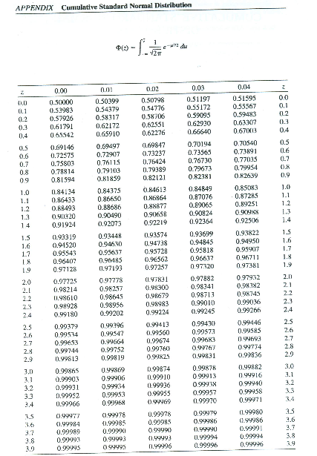
Normal Distribution Charts

Slide 7
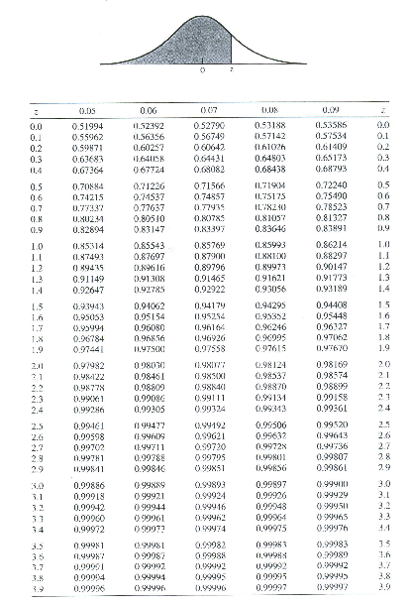
Normal Distribution Chart

Slide 8
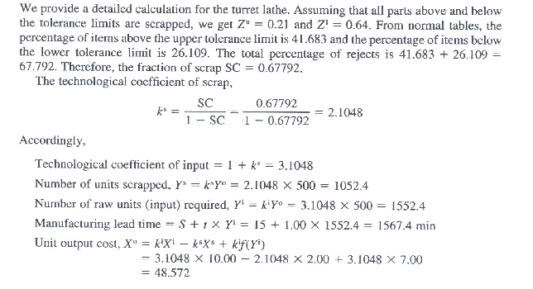
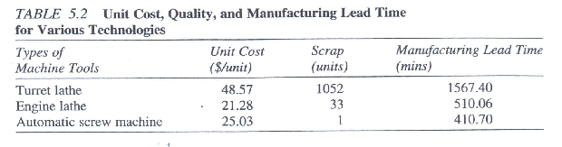
Solution

